Slide 1
CAR INSURANCE DATA CLAIM
Group – 5
Batch : PGPDSE-FT online Feb22
Mentored by:
Mr. Jatinder Bedi
Presented by:
Mitra Karthikeyan
Mohammed Umar Sharieff .M
Lalith .S
Manibalan .N

Slide 2
Business objective and Understanding
Objective - To check whether the customer has claimed the loan.
Proposed solution to the problem -
Using the visualization and plotting tools, we need to figure which age category people are lacking the awareness about the car insurance claim and need to educate them.
Problem understanding -
Today, the majority of the people own a car and it has become mandatory to opt for car
insurance. Many people apply for a loan to buy a car. It is necessary to explore the relationship between the age, gender, educational qualification, income of people who own car insurance and who have claimed the loan.
Also, we need to figure out the problems faced by the
vehicle insurance claims team.
Conclusions :
The observations or conclusions will be based on the visualization or plots. In the conclusion part
the relationship between each column will be established.
Reference to the problem:
https://www.acko.com/articles/general-info/5-common-problems-faced-by-vehicle-insurance-cl
aims-team/

Slide 3
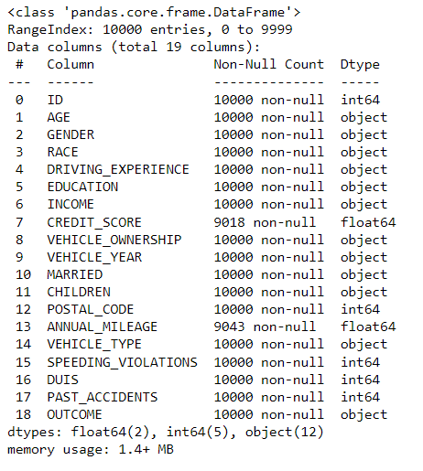
Dataset description
Independent variables:
Numerical column: 11
Categorical column: 8
Target variable:
Outcome - 1 [Categorical]
Shape of the dataset:
10000 rows and 19 columns
Dataset taken from KAGGLE :
https://www.kaggle.com/datasets/sagnik1511/car-insurance-data

Slide 4
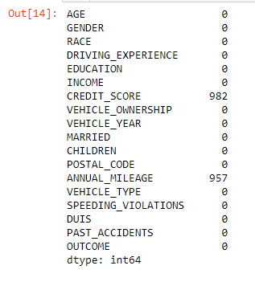
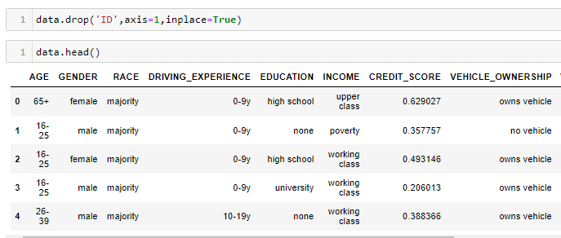
Data Processing
Missing values treatment
Null values
Removing Insignificant variables
As we can observe we have multiple
null values in columns ‘CREDIT_SCORE’
and ‘ANNUAL_MILEAGE’.
We removed the ‘ID’ column from our dataset as it
won't help us for the classification model we are working on.

Slide 5
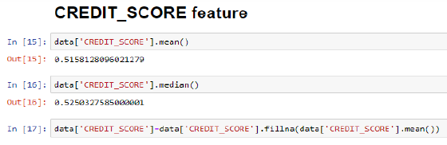
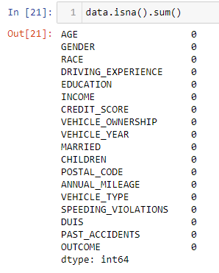
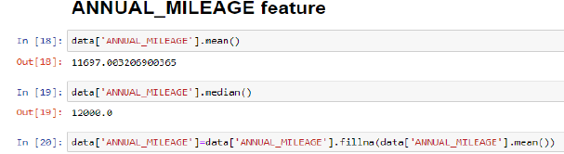
Treating the missing values
The mean and median values for both the columns
are similar. So, we have taken the lowest one to
apply on the null values.
Now, we can observe that both the columns
with null values have been filled in.

Slide 6
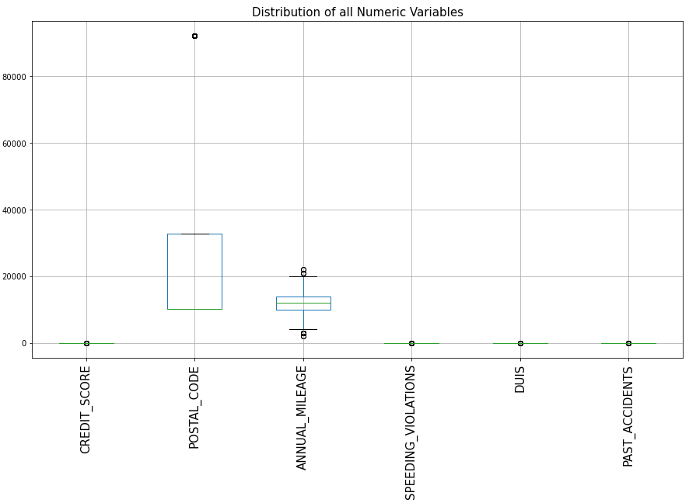
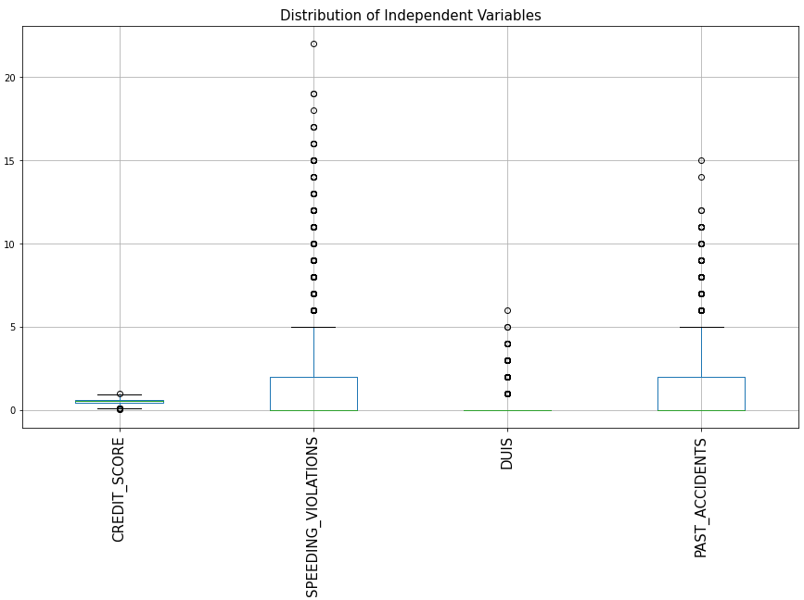
Exploratory Data analysis (EDA) and Feature engineering.
Outlier Analysis
Distribution of numeric variables
Distribution of independent variables
Dependent variable:
‘OUTCOME’ column is the dependent variable or
the target variable in this dataset. 0 indicates that the
people have not applied for the loan and 1 indicates
that the people have applied for the loan.
Independent variable:
The rest of the columns are independent variable which is not dependent on each other.

Slide 7
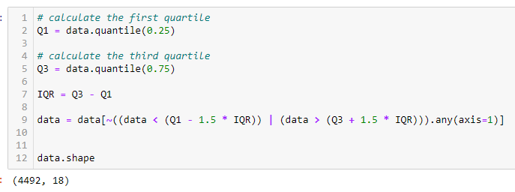
IQR Treatment
So after treating the data set with IQR Treatment we can observe
that the shape has reduced drastically compared to the original shape.

Slide 8
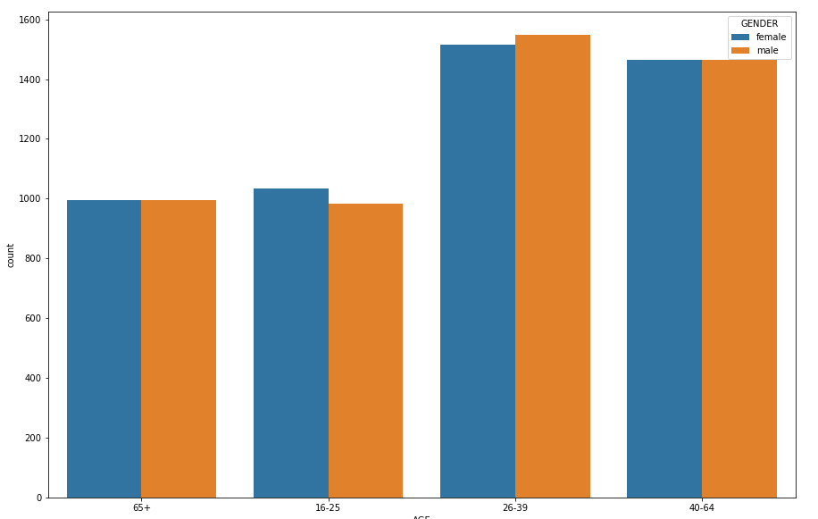
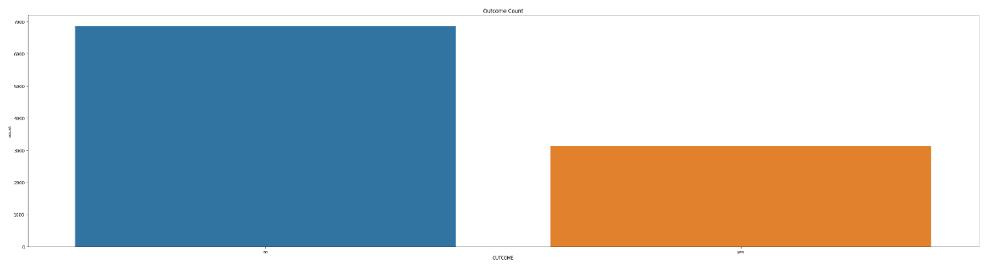
Validating Inferences Using Visualizations
Uni-variate Analysis :
Bi-variate Analysis :
Here we can infer that people between ages
26-64 have claimed loan comparatively higher
than the other age groups. The male gender seems
to be a bit higher between 26-39 age group.
The number of people who applied for loan is
significantly lesser than those who haven’t.

Slide 9
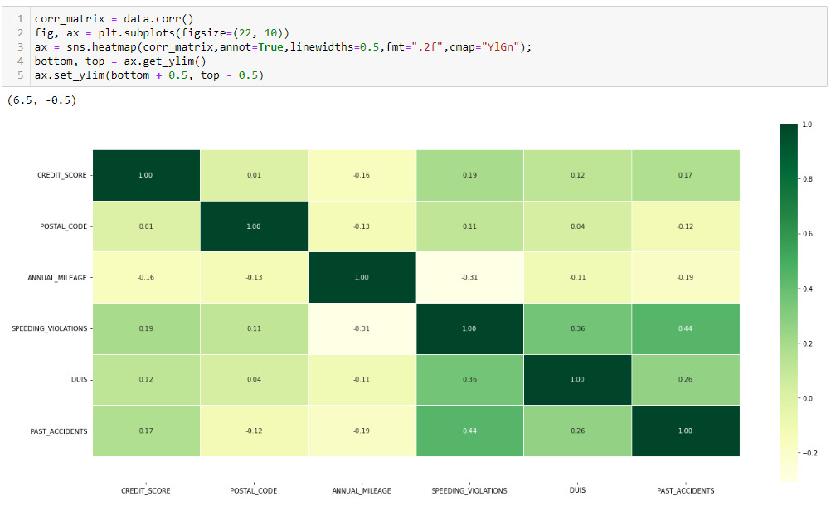
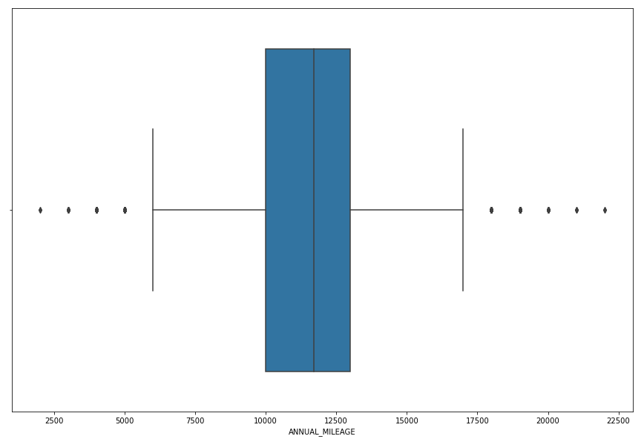
Correlation :
A Boxplot of the column ‘ANNUAL_MILEAGE’
shows us the Median lies between
100000 to 150000 miles. Also there
are some outliers present in the column.
Created a heatmap with the top 5 variables of the selected features.

Slide 10
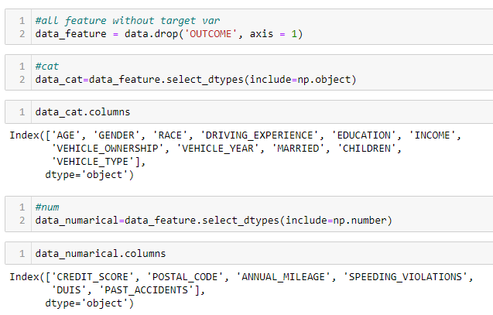
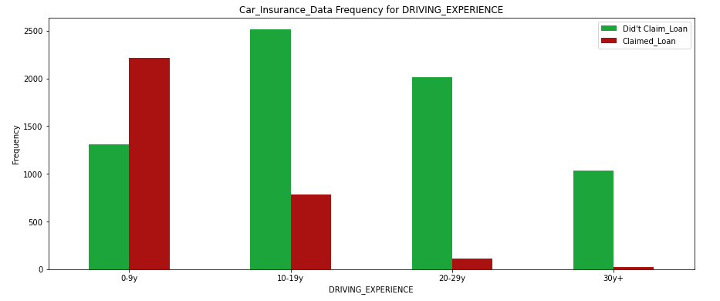
Car Insurance Data Frequency for DRIVING EXPERIENCE
Feature Engineering -
Analysis performed for people who claimed and did not claim the loan.
Adjusting the features will help the model to perform better when put across different algorithms.
People from the age of 0-9 and 10-19 have
claimed the maximum insurance.
Segregation the numerical and categorical
variables for the feature selection.

Slide 11
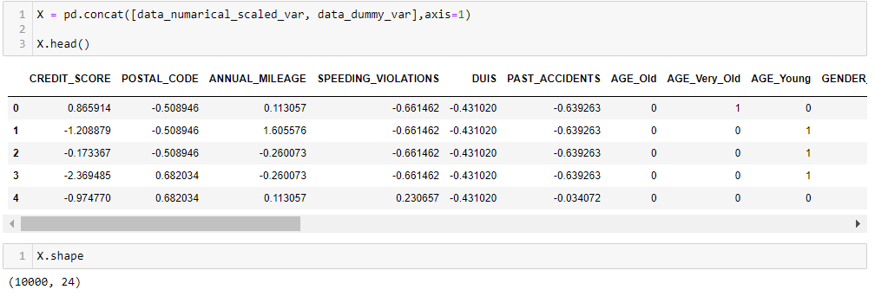
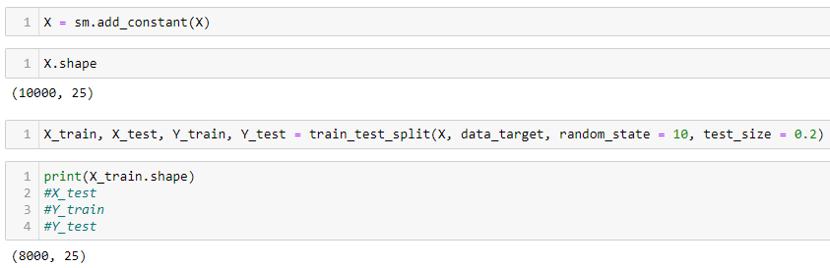
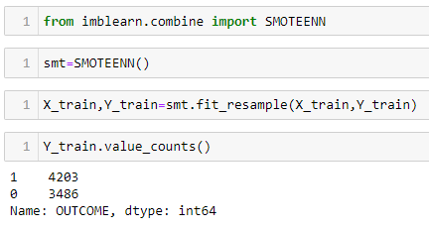
Feature engineering
After encoding categorical variables and scaling
numerical we concatenated the dataset to perform
train test split.
Train test Split
Train Test Split in order to estimate the performance of machine learning algorithms that are applicable for prediction-based Algorithms/Applications.
Handling the class imbalance for train data.
With the help of SMOTEENN from imblearn we
have smoothened the trained data.

Slide 12
Model Building
Dataset has target variable as categorical hence we can compared all models and do spot check on their performances basis roc_auc, precision and recall.
Logistic Regression
Decision Tree Classifier
Random Forest Classifier
XGBClassifier
Metrics to evaluate the model
AUC score
Precision score
Recall
Accuracy score

Slide 13
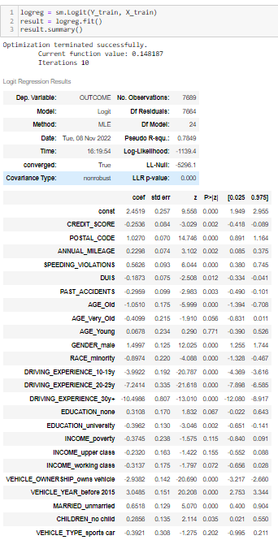
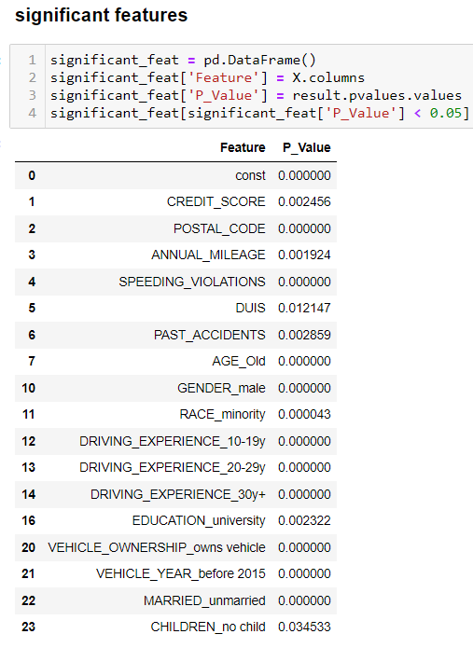
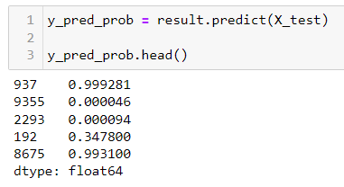
Base model - Logistic regression.
Finding out the Significant features that has the p-value
of < 0.05 from the data frame in order to perform
the predictions.
Results of Logistic Regression
Predictions on the test set :

Slide 14
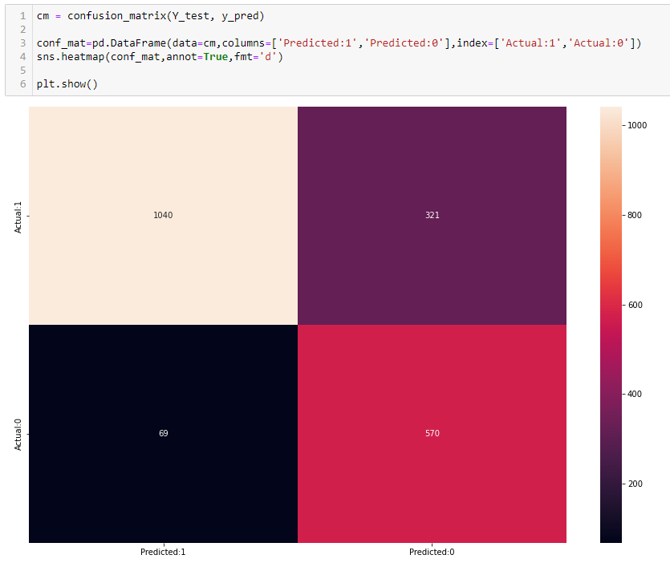
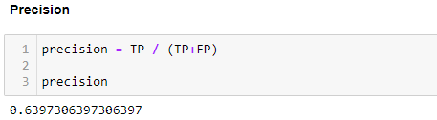
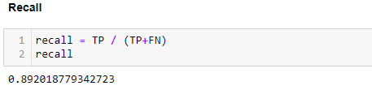
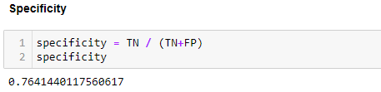
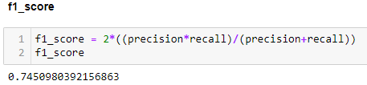
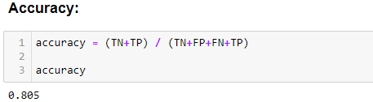
Confusion Matrix on Logistic regression.
Computed various performance matrix
on the predicted model.

Slide 15
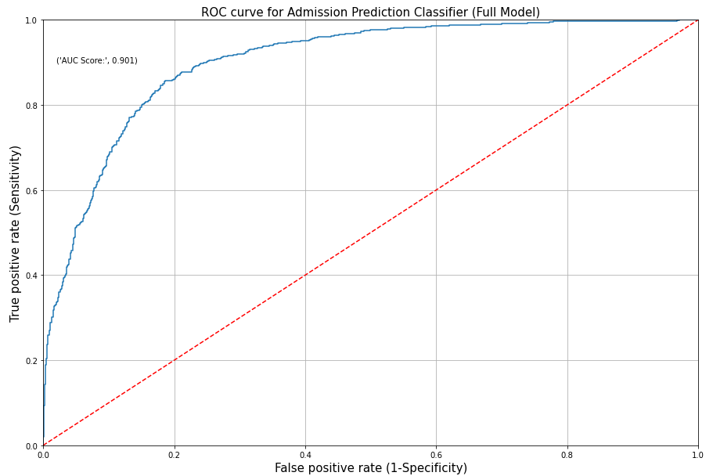
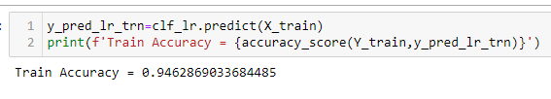

ROC curve for Admission Prediction Classifier (Full Model).
Train set accuracy :
Test set accuracy :

Slide 16
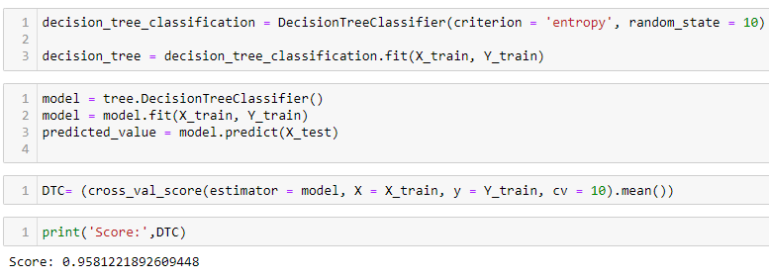
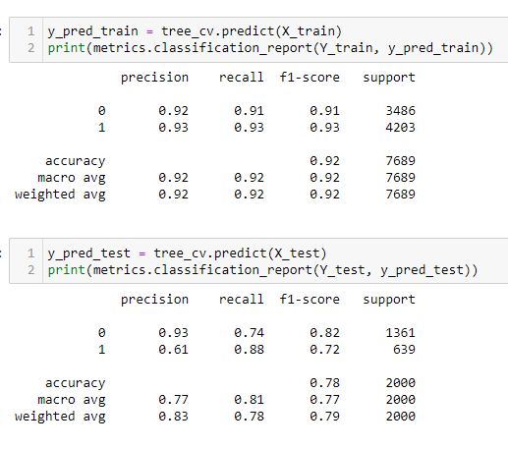
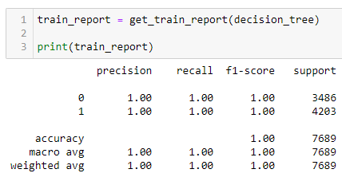
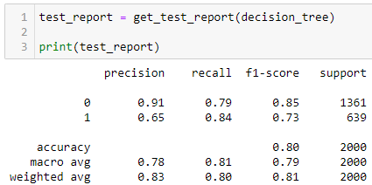
Decision tree classifier.
The main advantage of the decision tree classifier is
its ability to using different feature subsets and
decision rules at different stages of classification.
Model results after Hyperparameter
tuning using GridSearchCV
Train set -
Test set -
From the above output, we can see that there is slight significant difference between the train
and test accuracy thus we can conclude that the decision tree is less over-fitted after
specifying some of the hyperparameters.

Slide 17
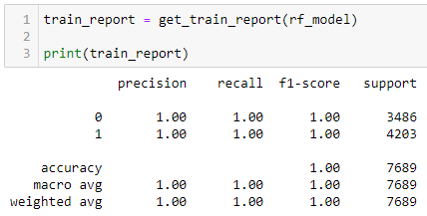
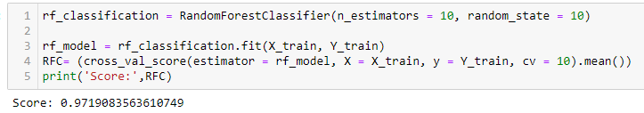
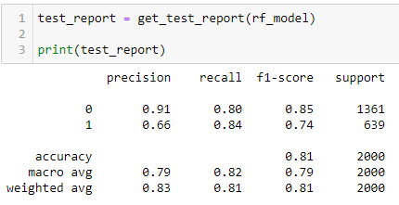
Random Forest for Classification
Performed to identify large number of relatively uncorrelated models (trees)
operating as a committee will outperform any of the individual
constituent models.
Performance measures on Train Test Set :
Interpretations :
From the above output, we can see that there is a difference between the train and test accuracy thus we can conclude that the Random Forest for Classification is over-fitted on the train data.
If we tune the hyperparameters in the Random Forest for Classification, it helps to avoid the
over-fitting of the Random Forest for Classification.

Slide 18
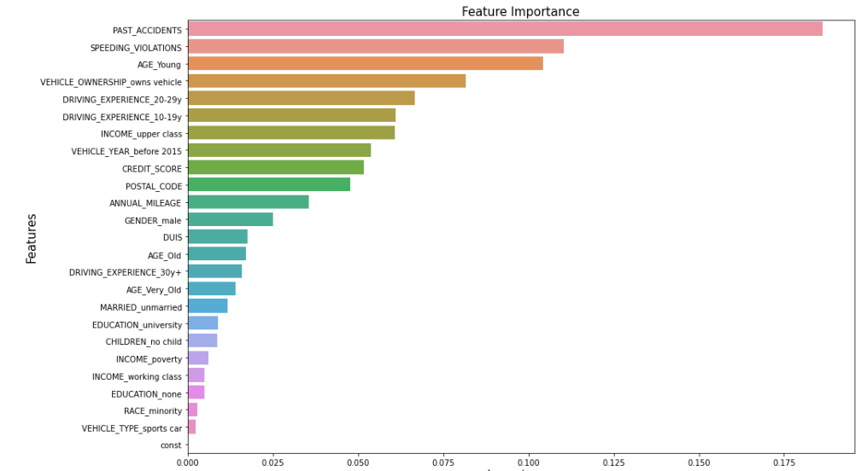
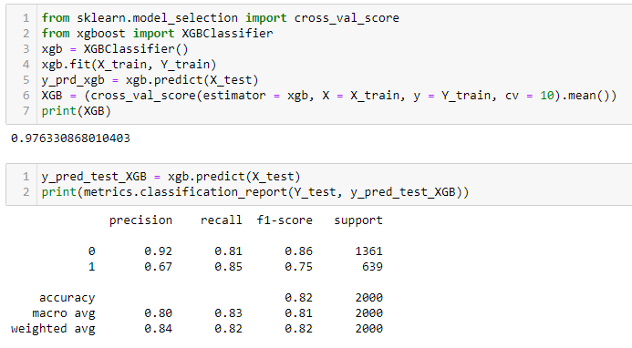
XGBClassifier
Performed in order to determine -
Numeric features should be scaled
Categorical features should be encoded
Important features to the model

Slide 19
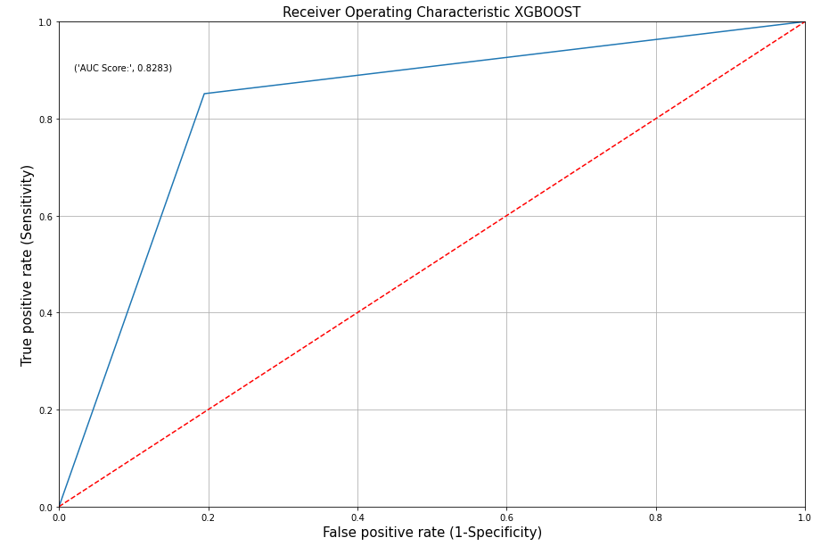
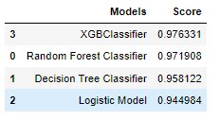
Receiver Operating Characteristic XGBOOST
Accuracy of all the models
performed and their scores
After comparing we came to the conclusion that the best performing model is the XGBClassifier

Slide 20
Thank you

